Slide 1
IMS Project
Kiera Hegarty

Slide 2
Structure
Step 1: planning [Jira and ERD]
Step 2: MySQL
Step 3: Java

Slide 3
Jira Board
Step 1: Create epic [Create an IMS project]
Step 2: Create user stories
Step 3: Add tasks with user stories
Step 4: Story point estimates

Slide 4
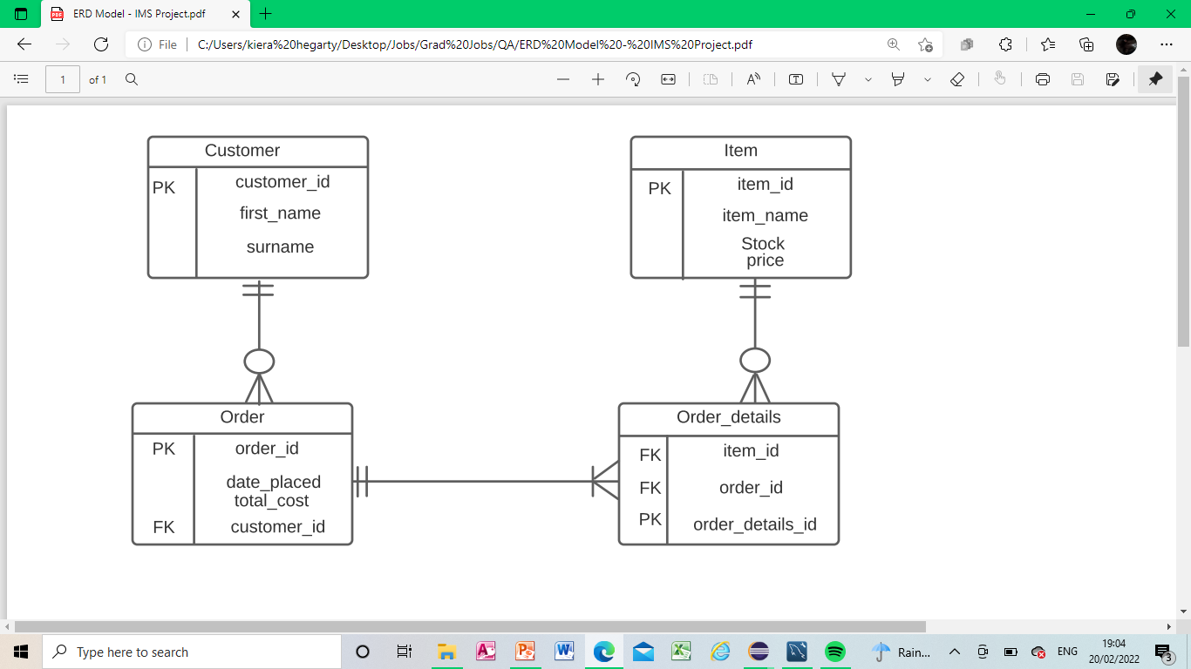
ERD Model

Slide 5
MySQL
Table 1: Customers
Table 2: Items
Table 3: Orders
Table 4: Order Details

Slide 6
Java
CRUD functions
{Demo provided}

Slide 7
Conclusion
User stories not complete
Trial code for adding items to orders

